Slide 2
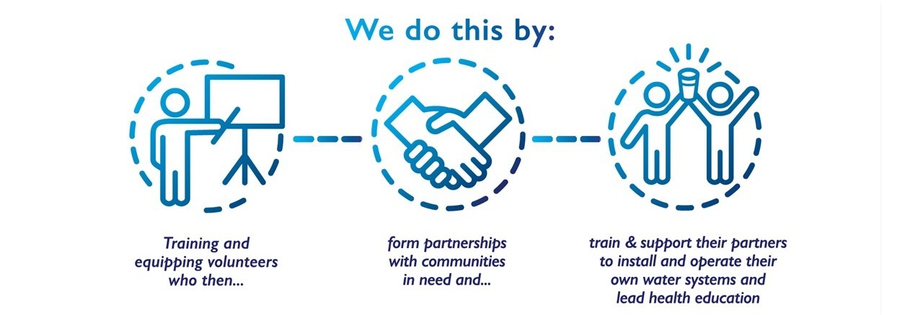

Slide 3
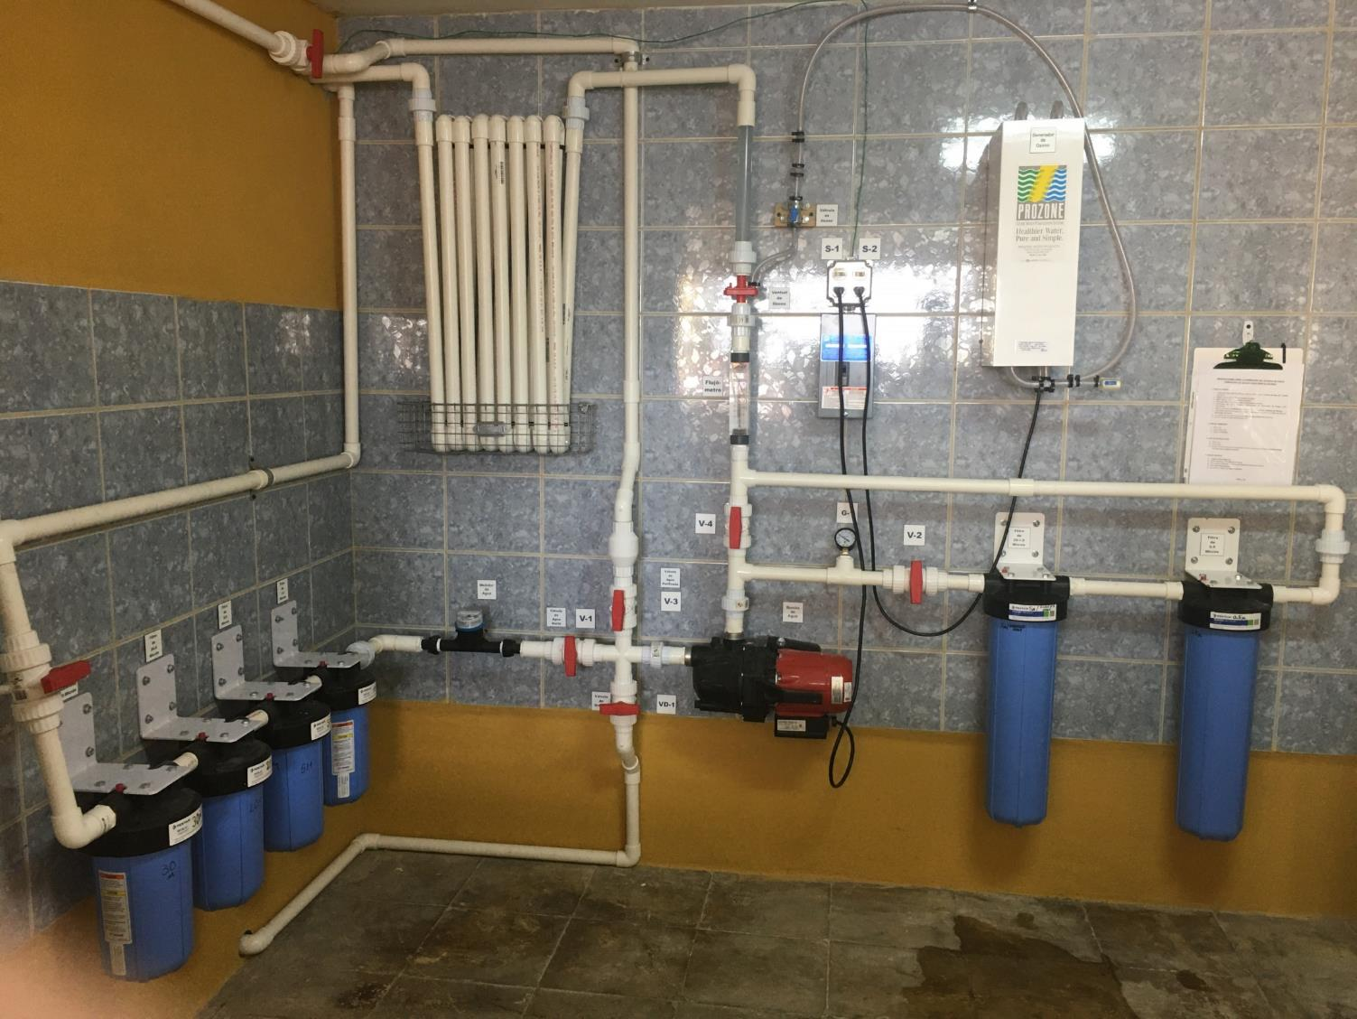

Slide 4
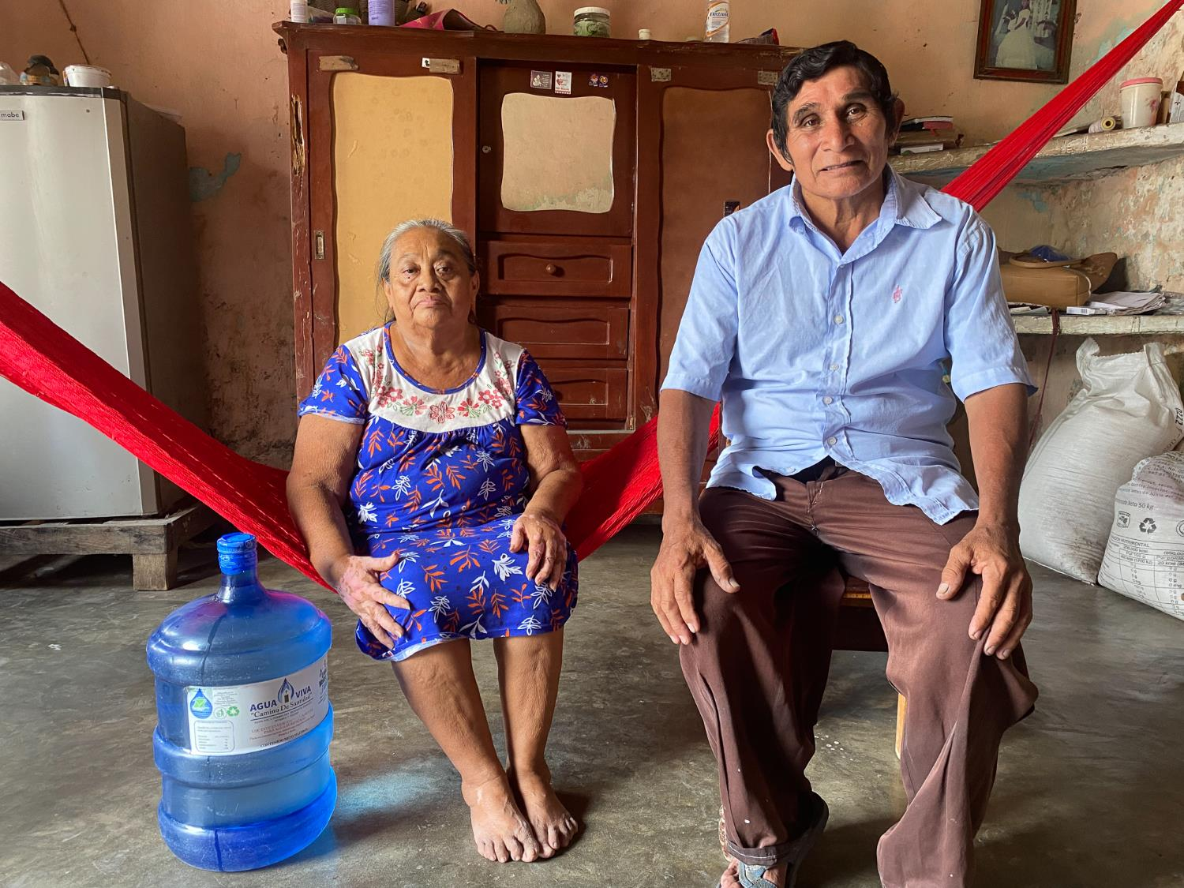
Notes:
Antonio and Maria, consumers of the water from the Carpizo water purification system. Before the system was installed they only drank water from the well. For the past 3 years, thanks to LWW they have only drank purified water. They feel better and are happy to see that their grandchildren are able to grow up healthy and drinking clean water.

Slide 5
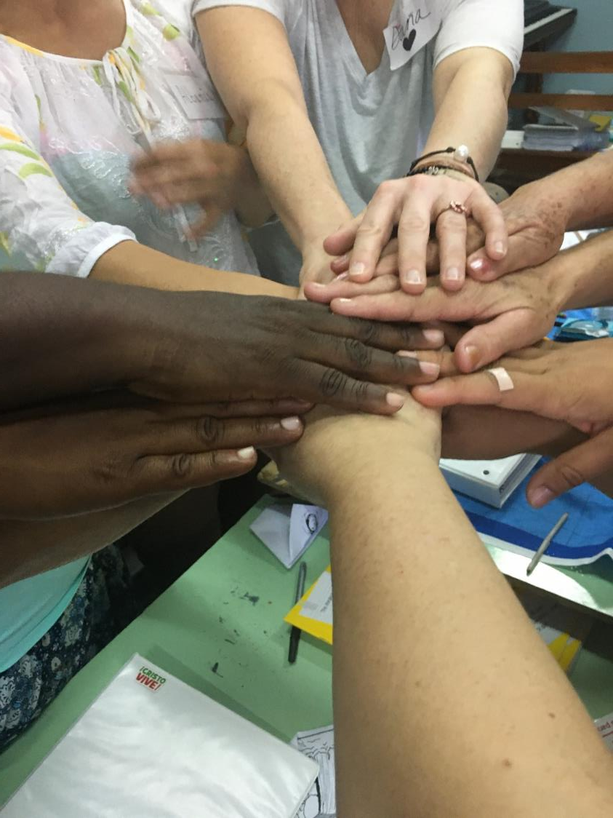

Slide 6
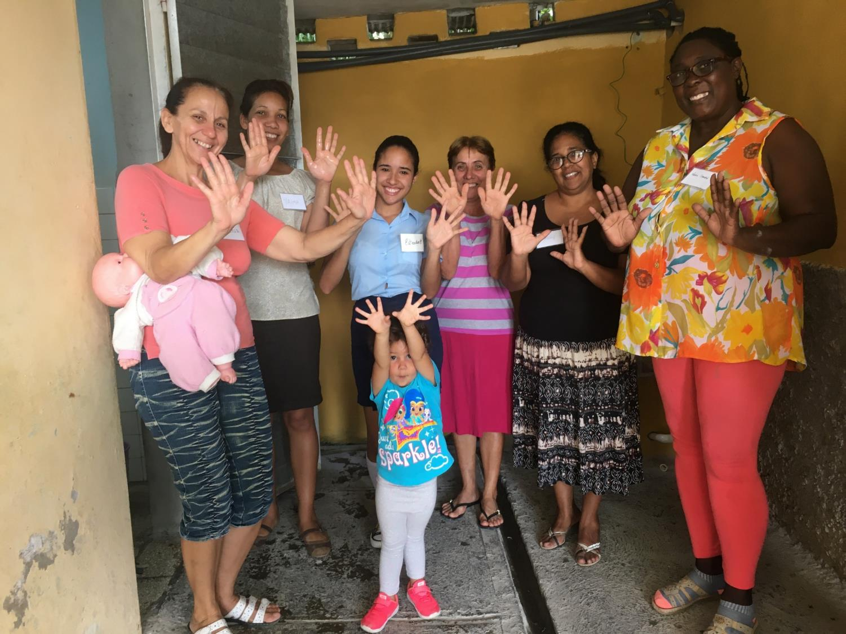
Notes:
Here is a photo of the health educators—the hand washing brigade joined by Sashi who was at church all day every day during the training and became quite the hand washing champion!

Slide 7
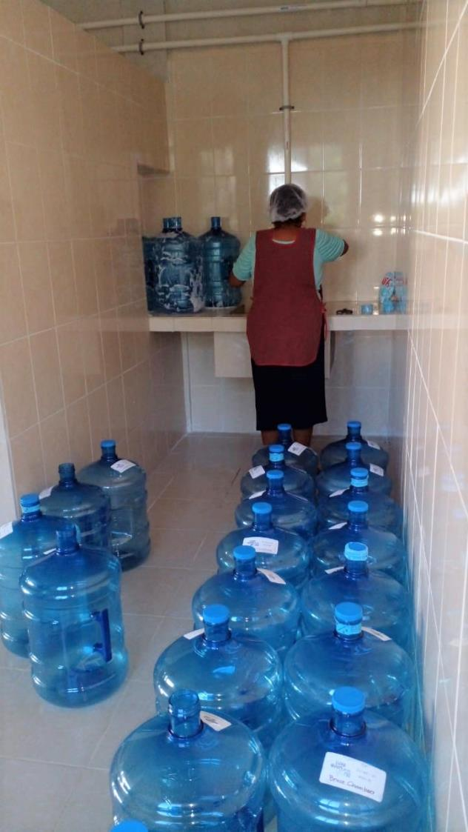
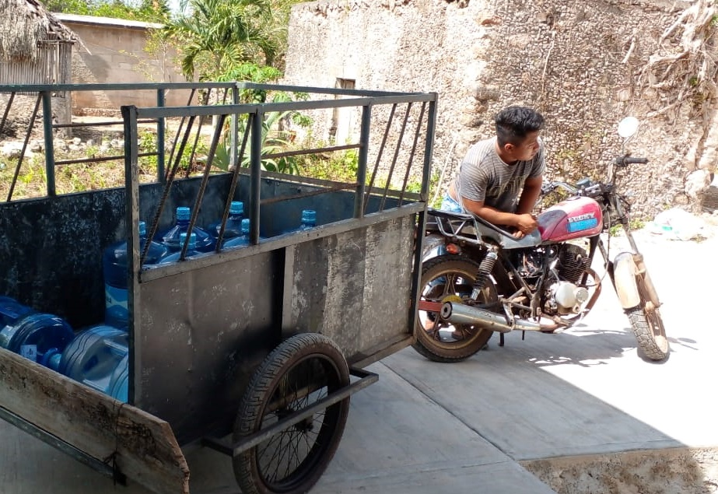

Slide 8
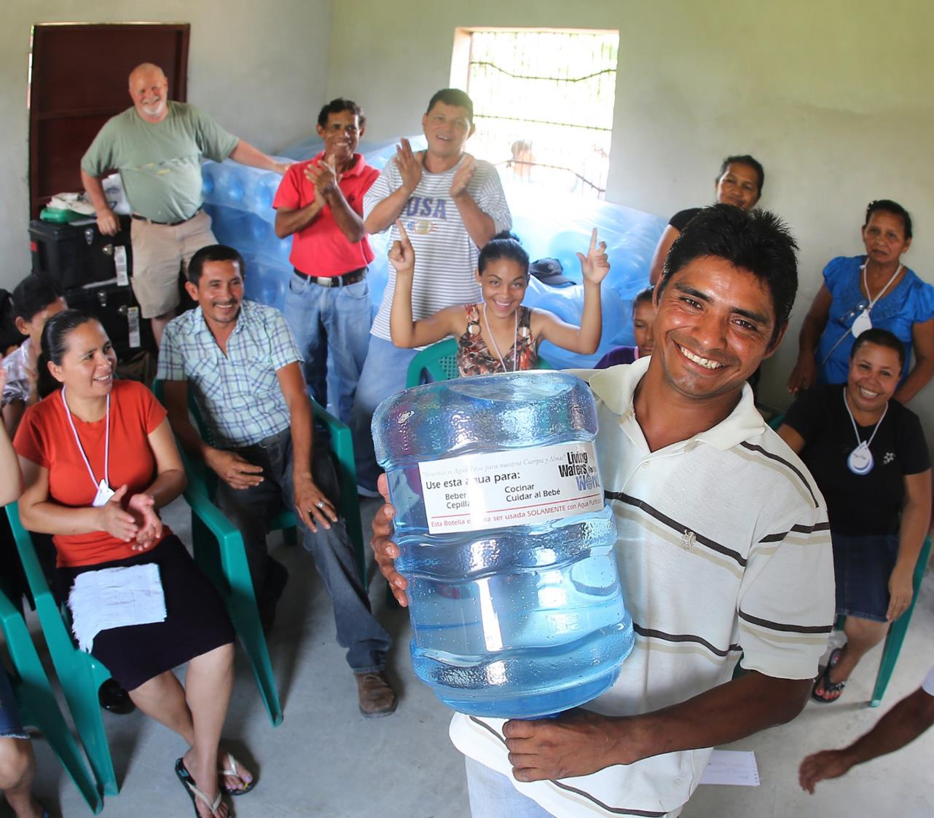

Slide 9
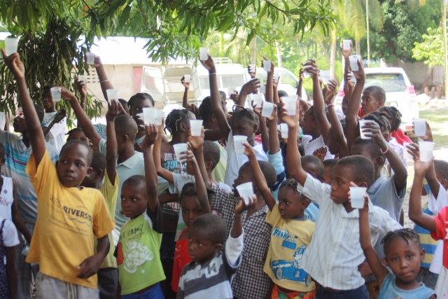

Slide 10
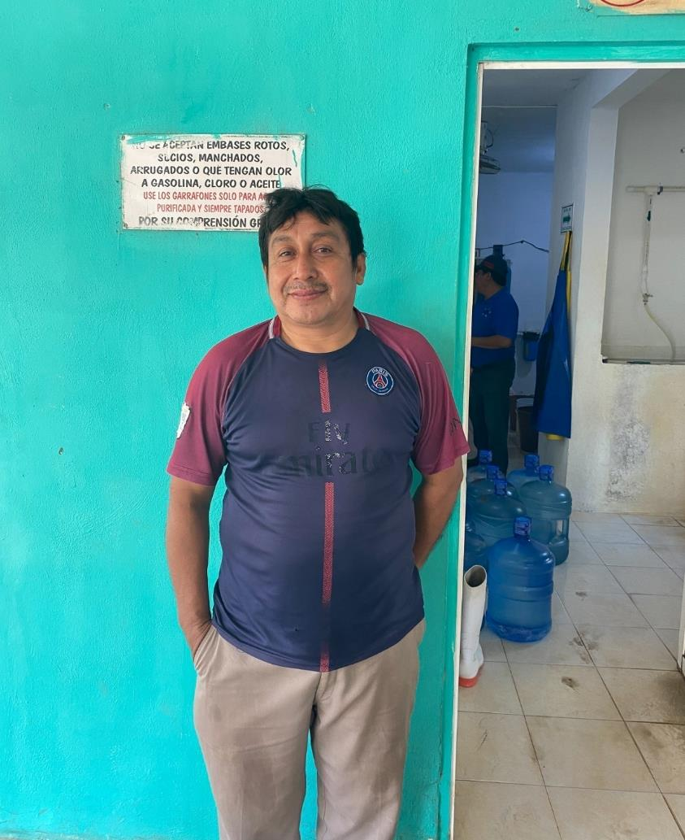
Notes:
Operator of the water system in Bethania, Mexico. The system was installed 14 years ago, he has been the operator from day 1. Serving about 100 bottles per day to the community.

Slide 11
Thank you!!

